Slide 1
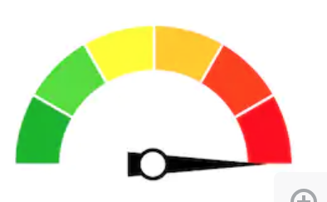

Now a super hot topic, very famous in ML
OVERFITTING
Overfitting will be a question for you in the interview. 100% sure - for Data Scientist Junior Position

Slide 2
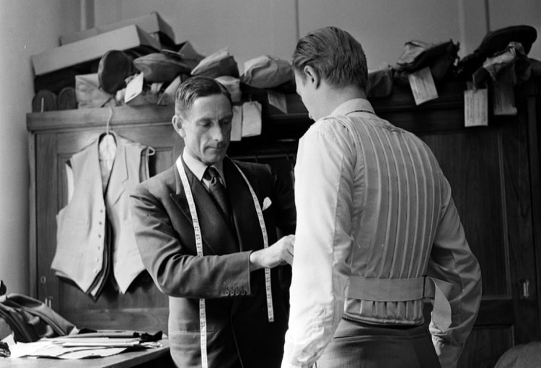

What is Overfitting? The tailor problem
Image you are a tailor. Your job is doing men clothes. In the same time arrives 5 customers, very similar in weight, height, torax etc etc. I said very similar, not perfectly equal. The 5 customers are our data. The suit is our model (math model). To save time, the tailor thinks: “mmmmmm...very similar bodies...I can save time measuring the first customer, make the suit and the simply replicating the suit for the other 4 customers”.
So, the tailor starts with the first customer, but the tailor measures too precisely him and made the suit. Unsurprisingly, the suit from first customer is not fitting the other 4 customer, why? Because the tailor took the measurements too precisely, taking into account the unique aspects of the first customers.

Slide 3
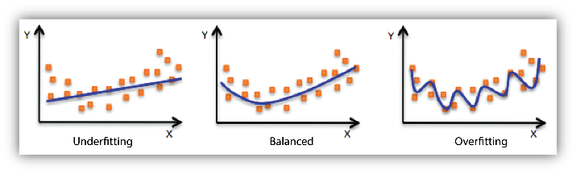
The moral of this story?
The tailor is the Data Scientist. The data are the customers and the suit is the ML model.
The error of the tailor is finding a compromise (trade-off) between being precise with the first customer but also make a suit that could fit the other 4 customers.
In ML is the same. When we have data, we have to find a model fitting the data well, but not so well, because we risk to fit the essence of the data + the noise. Well, overfitting is when the model is too adherent to the data, so much adherent that the model capture the nature of the data (distribution of data) + the noise.

Slide 4
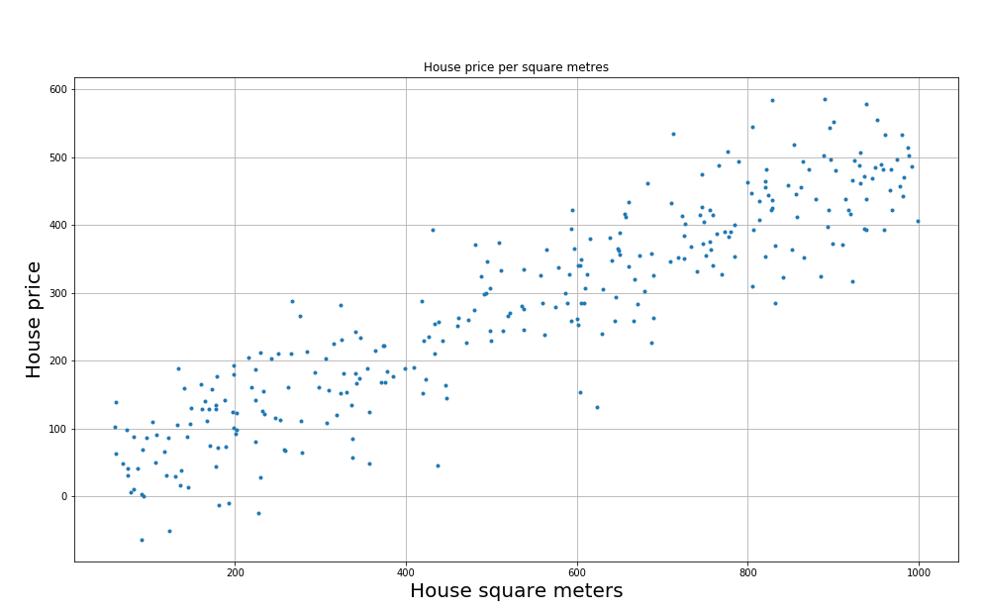
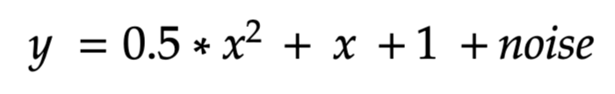
The irreducible noise
In fact, data are sampled from a population and data are always a partial view of the real problem.
In fact, in the data we have to assume that there always a part of noise, that is it random, and unpredictable. With overfitting, we are forcing the model to learn the noise.

Slide 5
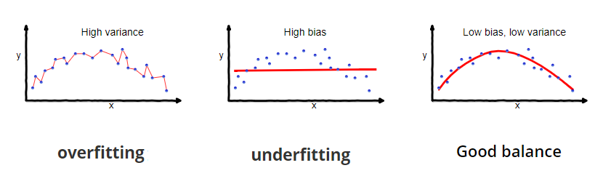
Bias vs Variance
In the “right” model given the data is when we have low bias and low variance.
High variance means that the model is very influenced by data: it is sufficient to move a bit one sample, and the parameters model change a lot. The model is too sensible depending on specific data. The model is too complex and is capturing intrinsic noise
High Bias means that the model is too simple. It is not flexible and is not able to fit the data properly.
Good balance, low bias and low variance. The model GENERALIZE well on unseen data.

Slide 6
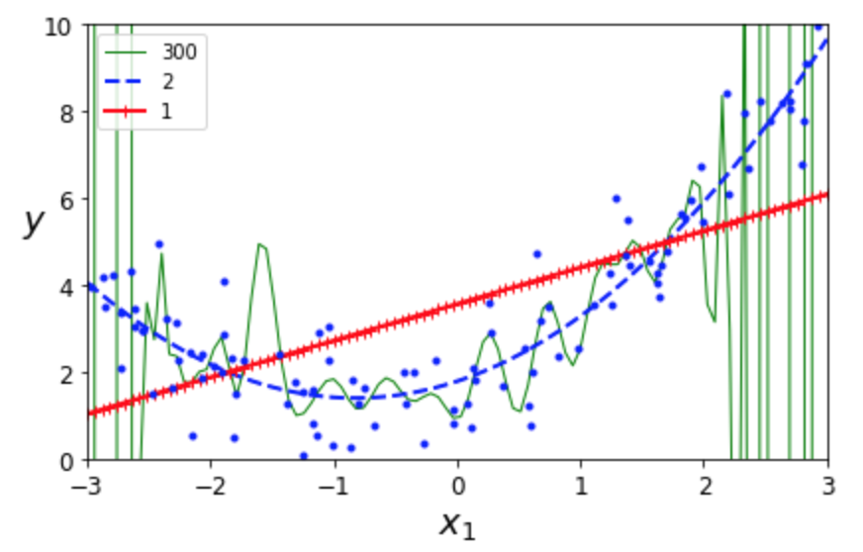
In Supervised Learning a good model should GENERALIZES well
A good ML model should GENERALIZE well on unseen data (use exactly this sentence when you are talking in a interview).
This means that the model can properly predict on unseen (new) data and has captured well the relationship between input and output and do not fit the noise.
Generalization concept is valid both for regression and classification tasks

Slide 7
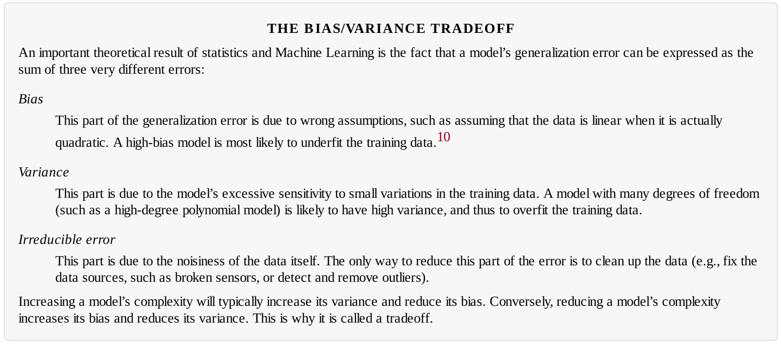
In Supervised Learning a good model should GENERALIZES well

Slide 8
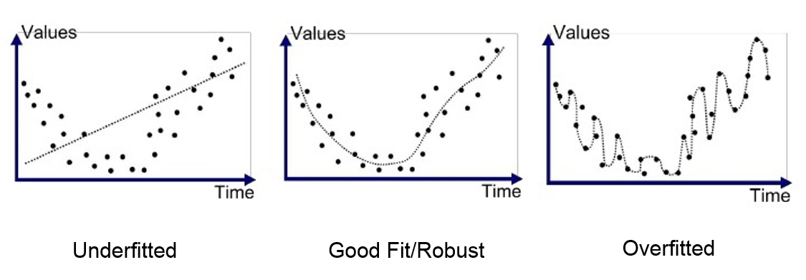
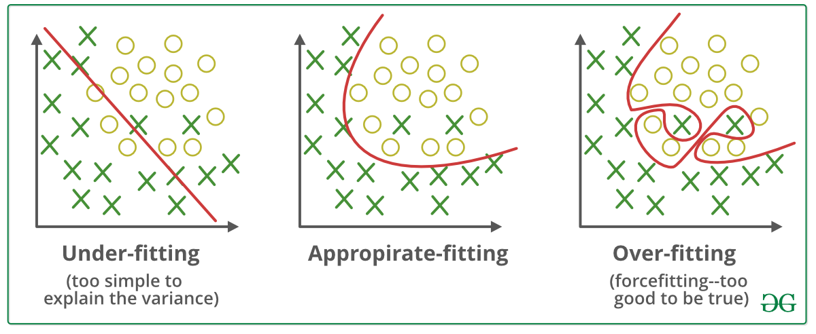
So, in simple words, what is overfitting?
Overfitting is when a model (regressor or classifier) can capture the noise in the data and so can reach very high score on the training set but very poor score on the test set.
This happens because the model is too much “flexible” and too much COMPLEX for the data we have.

Slide 9
Both regression and classification can suffer from overfitting
Both Regression and Classification tasks (ALL SUPERVISED ML) suffer from potential overfitting problems.
Regression
Classification

Slide 10

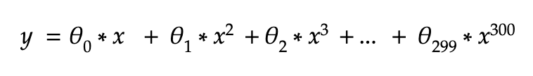
So, in simple words, what is overfitting?
Here for example (regression example) we have different models: a line (red), a parabola (blue), a very complex model (green).
Complex means in this case the maximum degree of the regressor model.

Slide 11
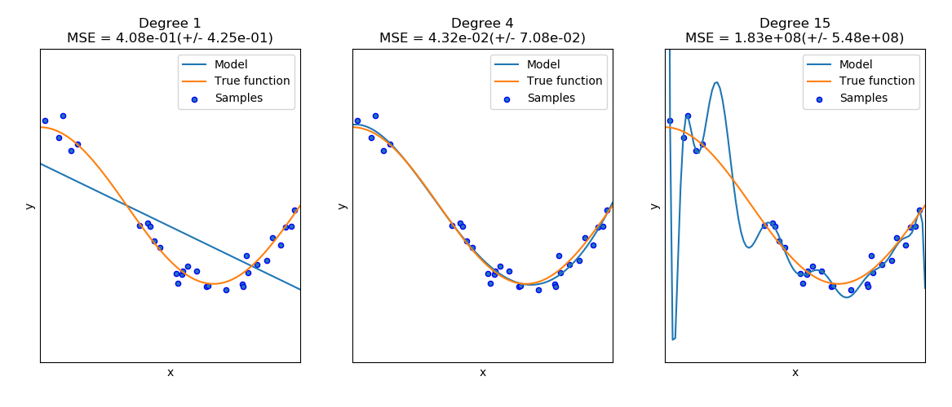
Overfitting Example

Slide 12
What is overfitting? How to prevent it?
Overfitting occurs when the model is “too complex” (too flexible) and adapt too well to data. In particular, the model is not able to generalize well and this means that it performs very well on training set and very poorly on test set.
Overfitting occurs when the model is so flexible that try to reproduce the noise (intrinsic in the data).
Overfitting can be prevented by choosing the right complexity of the model, and the right complexity depends on the data we have.
For example: for housing prices, which is the optimal degree that describes well the data without being too complex? (see Occam Razor on Wikipedia).

Slide 13
Regularization

Slide 14
Regularization
For Linear Regression and Polynomial Regression, REGULARIZATION is a solution to prevent overfitting.
Regularization is a way to control the model complexity in Linear Regression and Polynomial Regression. With regularization, you penalize the model when the weights of the model grows too much and this oblige the model to lower the values of the weights. There exists 2 regularizations:
Lasso Regularization
Ridge Regularization
Lasso and Ridge are ONLY applicable specifically to Linear Regression!

Slide 15
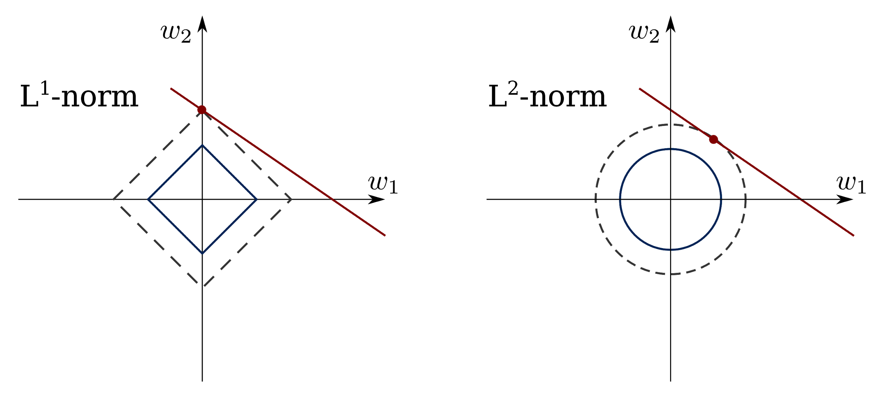


Regularization: Lasso (L1) and Ridge (L2)

Slide 16
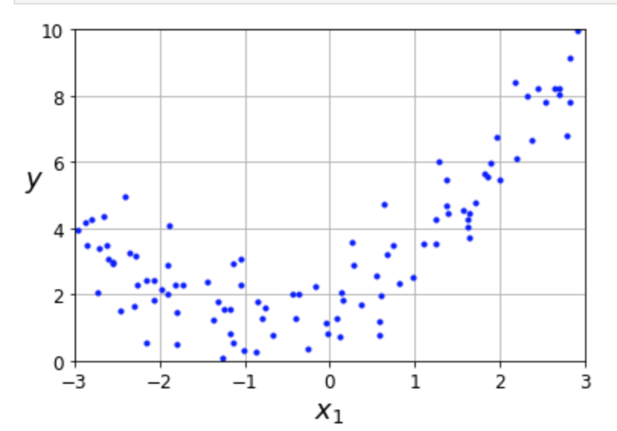
Lasso Regularization (L1 Regularization)
Suppose we have this model for a quadratic problem:
Obviously we chose a model that is too flexible (degree 6). Lasso regularization tries to simplify the model turning off (turn them to zero) some weights.
Lasso Regularization is saying: hey, the red circled parameters are not useful!
You can remove them from the model! Used as Feature Selection

Slide 17
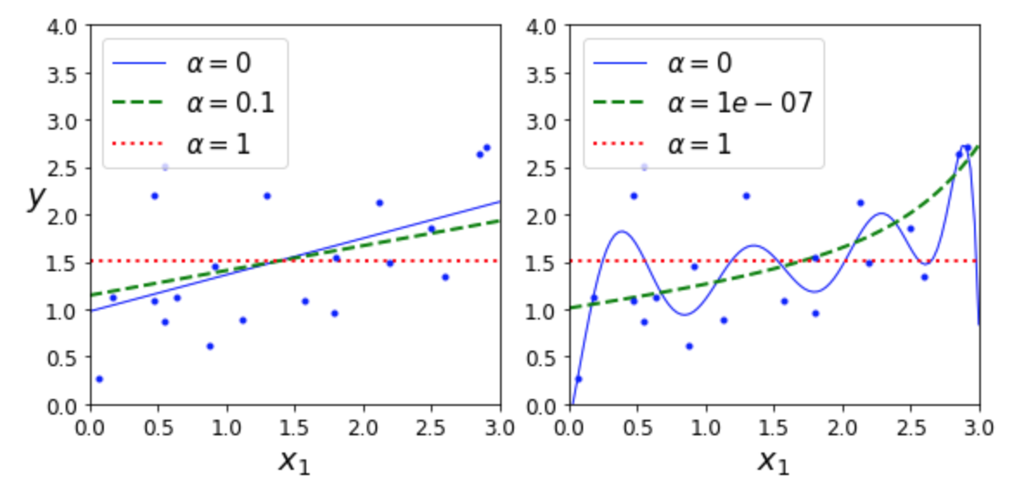
Lasso Regularization (L1 Regularization)
Linear Regressor with Lasso
Polynomial Regressor with Lasso

Slide 18
Ridge Regularization (L2 Regularization)
Suppose we have this model for a quadratic problem:
Obviously we chose a model that is too flexible (degree 6). Lasso regularization tries to simplify the model decreasing all the weights

Slide 19
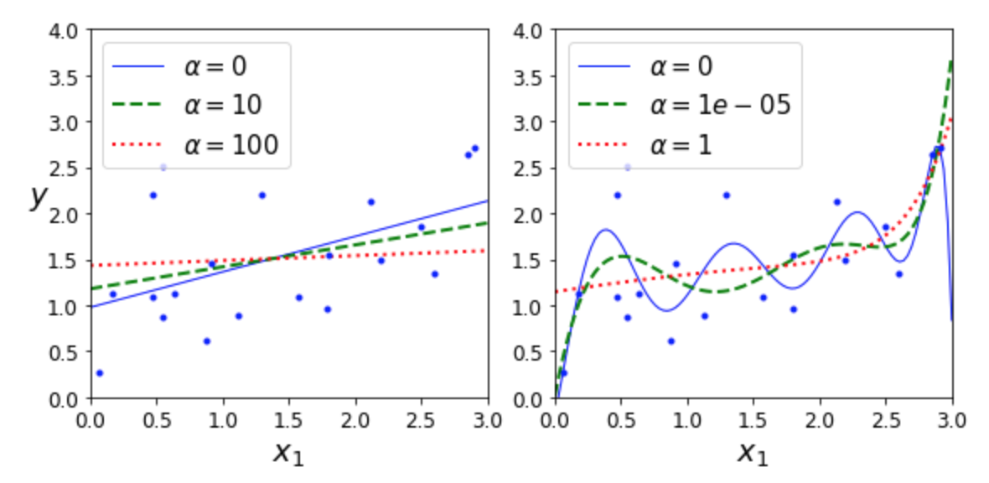
Ridge Regularization (L2 Regularization)
Linear Regressor with Ridge
Polynomial Regressor with Ridge

Slide 20
What is regularization and what is it for?
Regularization is a way to prevent overfitting and it works because it decreases the complexity of the model, so making the model more simple and less “flexible”.
Regularization helps when we are facing overfitting.
Underfitting is the opposite: the model is not complex enough and is not able to describe the data because has not enough flexibility.
ADDITIONAL MATERIAL about overfitting

Slide 21
Go to Section 4 and 5
Linear Regression Notebook, section 4

